Slide 1
Victim Care - Disclosure
Domestic Violence In the Christian Home

Slide 2
Introduction:

Slide 3
Disclosure Process - thoughts
Find a safe place to talk.
Ask about her safety.
Establish your desire to help.
Cover elements of confidentiality.
Let her tell her story.
Believe her.
What are her expectations in meeting with you?
Inquire about practical ways to help.
What is the safest way to communicate going forward?
Pray and follow-up

Slide 4
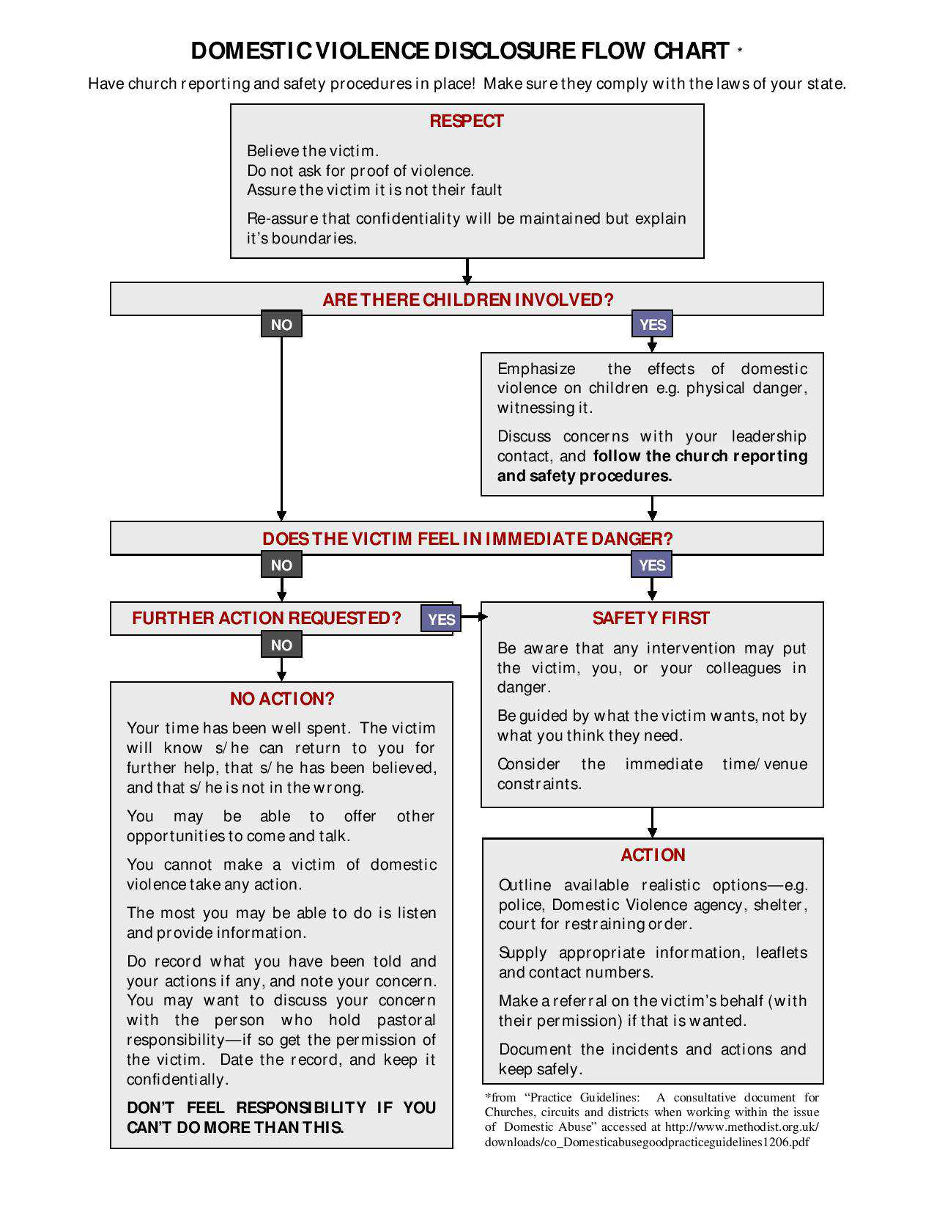
Disclosure Process – Flow Chart

Slide 5
Disclosure Process – In Marriage Counseling?

Slide 6
Domestic Violence In the Christian Home

