Slide 1
Caring for victims of domestic abuse
Joy forrest
Called to peace ministries
Notes:
Victim v. survivor terminology

Slide 2
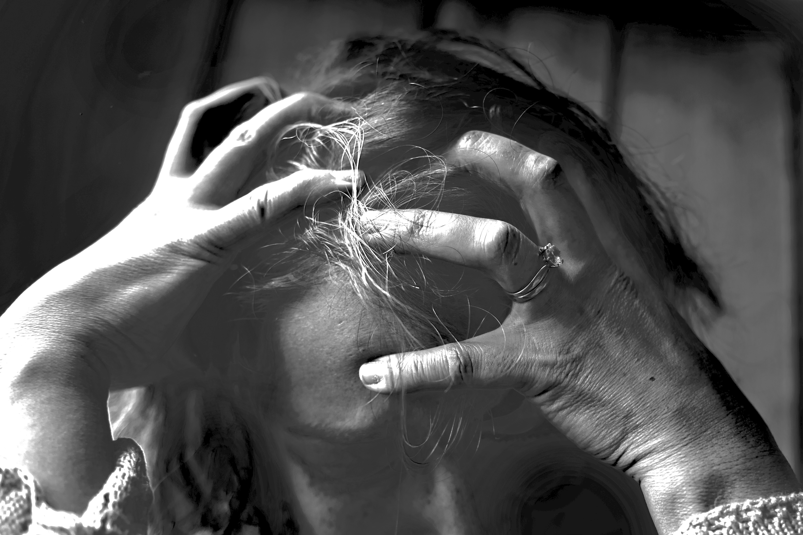
A sad state of affairs
Domestic Violence affects as many women in the church as in society at large.
Notes:
My experiences at the shelter…

Slide 3
“Numerous studies show that evangelical men who sporadically attend church are more likely than men of any other religious group (and more likely than secular men) to assault their wives.”
Steven R. Tracey: “WHAT DOES “SUBMIT IN EVERYTHING” REALLY MEAN? THE NATURE AND SCOPE OF MARITAL SUBMISSION”
Notes:
Sadly their understanding of scripture feeds their sense of entitlement. We have wolves in sheep’s clothing among us. Our support group demograhics are proof. SADLY OUR CHURCHES ARE FOOLED AND MISS IT.

Slide 4
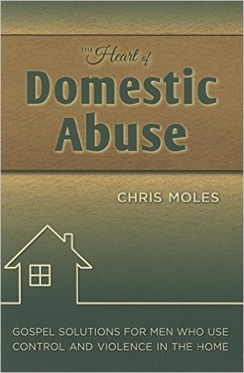
THE CHURCH’S RESPONSE?
“What struck me about that meeting were the stories of abuse. These women had not endured a single abusive event but in most cases they had lived through decades of abusive, controlling, and violent behavior. But that was not the only thing they had in common. The majority of the women in the room were now either being disciplined or shunned by their own church.”
Chris Moles, The Heart of Domestic Abuse
Notes:
At shelter—Christian women coming in overwhelmingly the same experience.
Radio show: Why does my pastor are more about my marriage than my life… as a counselor, women referred to me for multiple churches. Sadly, it’s not just churches, but Christian/ biblical counselors. The fact is we’ve gotten it WRONG!
I’ve never seen an abuser undergo church discipline, but have seen scores of victims who have. Bad witness to shelter workers.

Slide 5
ACTUAL Counsel victims received:
"Read this book on how to be a better wife.”
“You need to work on being more submissive.”
“Respect him more, and it will work out.”
"You need to attend marriage counseling together”
“You caused him to do this.”
Notes:
I ASKED ONLINE GROUPS & WAS INUNDATED WITH RESPONSES… MANY MORE. “Jane Smith has a difficult marriage, too. It seems like you think you’re the only one.

Slide 6
“Pray more, read your bible, have more sex.”
“Just forgive and forget and you can move on.”
“Let God handle him, suffer for Jesus.”
”You need to love him more.”
“He didn’t mean to hit you.”
Notes:
Honestly, I think the most damaging thing is that pastors place ALL the responsibility on the wife’s shoulders to do things to “change him.” It never works. What’s really needed is swift and strong action against him-if just one person had looked at my ex and said “You are NOT going to treat her this way or there will be consequences” and then did exactly that—he wouldn’t have continued, then and now. His arrogance was fed in my former church—he still attends because it’s safe for him. He’s still abusive, and unrepentant.

Slide 7
“Don't do anything to prevent your husband from killing you. Do not fight divine providence.”
“You are bitter- you need to forgive him.”
“If you don’t keep lighting those matches, he probably won’t keep exploding.”
“Just have more sex with your husband.”
He didn’t just hit you for no reason. What did you do?”
“CARLY’S” STORY
Notes:
ONE WOMANS STORY
We went for Church counseling several times. We met with another couple in the church. Every time I walked away with more brokenness. It was becoming apparent that my role as his wife was to submit. No matter what. I was to wait until God changed his heart and showed him how to be more loving. More compassionate. More controlled with his words. I prayed and prayed. I talked to people from my church. An elder from our Church came to counsel us at our home. It was evident in the first few minutes, he was not there to counsel us. He was there to counsel ME. He advised that I was not to leave my marriage. I was to stay and wait for my husband to change. For his heart to change. I shared extremely personal details no one knew about our marriage. Things that have shattered me emotionally. I was told to stay.
I had loved my church community. But I was basically shunned from my small group, and eventually removed from the church. I cannot even to begin to count the number of times I begged peopled including the above person to work with my husband. We went to counseling at the church. It was always turned back onto me. Submit to your husband. No matter what.

Slide 8
WhAT DOES THIS COUNSEL HAVE IN COMMON?
THE BURDEN OF THE ABUSE IS PLACED ON THE VICTIM.
He who justifies the wicked and he who condemns the righteous, both of them alike are an abomination to the LORD. Pr. 17:15
IT DOESN’T WORK!
Honoring a fool is as foolish as tying a stone to a slingshot. Pr. 26:8
“It was my dad who really pointed that out to me. He said, "You could be Mrs. America and it still wouldn't matter. He will still cheat. He will still lie. My dad said it has nothing to do with you and everything to do with him!"
Notes:
DOES SHE HAVE SIN? OF COURSE, BUT NOT WHAT YOU THINK. NOT CAUSING THE ABUSE OR PROVOKING.

Slide 9
Why have we gotten it so wrong?
Abusers are often very charming in public
We elevate marriage over people (blind to the impact)
Victims can seem unreliable (stressed, anxious, overly emotional) or they cover it so well it’s hard to believe when they finally speak up

Slide 10
Why have we gotten it so wrong?
WE HAVE FAULTY ASSUMPTIONS
It’s a marital problem
Abuse is provoked (victim blaming)
If it’s not physical, it’s not abuse

Slide 11
How to help:
Believe them!
Listen and don’t try to take charge.
Educate them on the dynamics of abuse.
Notes:
Even though it may seem hard to believe, because the abuser seems so nice, the percentage of folks who feign abuse is very low. Yet, in our experience, most victims tell us their stories are doubted when they finally get up enough courage to divulge their secret. They’ve been conditioned to cover up, so the facts may be shocking and hard to believe, but please don’t put the burden of the proof on the victim.

Slide 12
How to help:
Connect them with resources.
Advocates/ DV Service Providers/ Support Groups
Counselors who understand DV
Don’t betray their confidence. (This can endanger them more!)
Help them make a safety plan. (NCADV, etc.)

Slide 13
How to help:
Encourage them to document the abuse.
Provide them with practical resources.
Shelter/Housing
Transportation
Basic Necessities (Food, clothes, childcare)
Notes:
Even though it may seem hard to believe, because the abuser seems so nice, the percentage of folks who feign abuse is very low. Yet, in our experience, most victims tell us their stories are doubted when they finally get up enough courage to divulge their secret. They’ve been conditioned to cover up, so the facts may be shocking and hard to believe, but please don’t put the burden of the proof on the victim.

Slide 14
How to help
Encourage them to set healthy boundaries.
Accompany them to court.
Encourage them to find hope in God.
Be patient! It’s a process!
Notes:
BE COMMITTED LONG TERM!! EXAMPLE JIM UPCHURCH.
"It is very tempting to take the side of the perpetrator. All the perpetrator asks is that the bystander do nothing. He appeals to the universal desire to see, hear, and speak no evil. The victim, on the contrary, asks the bystander to share the burden of pain. The victim demands action, engagement, and remembering. . In order to escape accountability for his crimes, the perpetrator does everything in his power to promote forgetting. If secrecy fails, the perpetrator attacks the credibility of his victim. If he cannot silence her absolutely, he tries to make sure no one listens." Judith Herman, MD, Trauma and Recovery,

Slide 15
Reasons Victims may resist attempts to help
They may not consider their relationships abusive.
Victims are conditioned to cover up and hide the abuse.
They do not want to leave their relationships (often because of their religious beliefs)
Notes:
Most don’t come to us and tell us they are victims, most are confused, and just know something isn’t right. Feel like they are crazy or responsible. Nothing they do is good enough. I feel like I have been playing whack-a-mole during my entire marriage, thinking that if I just change this thing, eliminate this thing, *this* is what's really making him unhappy, that at some point things could be better. Of course when that isn't the issue anymore, it's something else. He changes his mind about where he stood on that topic, and wants me to change back now…
My husband’s first language is lying, his second language is English.
IT MAY NOT BE PHYSICAL BUT STILL IS DANGEROUS IF YOU’RE LOOKING AT THE BEHVIORS ON THE P&C WHEEL.
Even though it may seem hard to believe, because the abuser seems so nice, the percentage of folks who feign abuse is very low. Yet, in our experience, most victims tell us their stories are doubted when they finally get up enough courage to divulge their secret. They’ve been conditioned to cover up, so the facts may be shocking and hard to believe, but please don’t put the burden of the proof on the victim.

Slide 16
Reasons Victims may resist attempts to help
They do not believe they can survive if they do leave.
They are afraid, and believe the abuse will get worse if they leave, or that their children will get hurt. (75% of domestic violence homicides occur after the victim leaves. Statistics are much lower for women who seek DV related services prior to leaving.)
Notes:
Dangerous!!! Even if never physical. 75% of homicides AFTER she leaves.

Slide 17
Keys to healing
Recognize the Abuse
We must face the ugly truth before we can apply His beautiful truths (including the impact of trauma).
Power & Control Wheel & Education
Identify and reject lies!
Making excuses for the abuse
Taking responsibility for the abuse
Poor interpretation of Scripture (marital roles, identity, etc.)
Notes:
For many trauma is the hardest part—PTSD. Really CTSD- no less severe than combat veterans.
Leslie Vernicks books Emotionally Destructive Relationship and Marriage.

Slide 18
Keys to healing
His Word & His Spirit (Believers have supernatural resources )
Deal with Anger God’s way
Pour it out to Him (Ps. 62:8)
Refuse to let it consume you (Eph. 4:26)
Choose to Forgive
Not minimizing what happened
Leaving justice in God’s hands (Rom. 12:19)
Trust & relationship may not be reestablished
It’s a choice
Notes:
Living with abuse gives us plenty of reason to be angry, but sometimes our anger becomes sinful and destructive. Unfortunately, when that happens we often find ourselves living with negative consequences. Proverbs 22:24-25 warns, “Do not make friends with a hot-tempered person, do not associate with one easily angered, or you may learn their ways and get yourself ensnared.” We can easily find ourselves compounding the pain and misery of an already bad situation by allowing anger to rule our hearts. It seems that unresolved anger opens our lives to Satan’s destructive schemes (Eph. 4:26-27). In reality, much human anger reveals a lack of trust in God. We may be questioning why He has allowed bad things to happen in our lives, and if He really cares. In our minds, we profess that He is good, but in our hearts we doubt it.

Slide 19
Keys to healing
Knowing His Love & Goodness – CTPM Scripture Database
Knowing Your Worth- Identity in Christ
True Worship (vs. Idolatry)- Make God bigger than the abuser
Establish boundaries
Learn Healthy Relational Patterns & Wise Trust
Notes:
IDOLATRY IS OFTEN THE VICTIMS SIN--- WE’VE JUST SCRATCHED THE SURFACE… EACH OF THESE POINTS COULD BE AN ENTIRE SESSION. HOPE YOU’LL COMMIT YOURSELF TO LEARNING MORE, AND TO HELPING THOSE OPPRESSED BY ABUSE. (GOD’S HEART)

Slide 20
All of this info can be found in greater detail in my book-- coming in early 2018!
Visit the Blue Ink Press table to learn more.
Notes:
Next is a curriculum.

